Slide 1
JFC CYJL: A Time-Sensitive Tip to Help Donors Turn “RMDs” Into “QCDs” With a Match From the Treasury
July 29, 2020
Presenter: Bill Freedman

Slide 2
A Quick Tutorial on “Required Minimum Distributions” – “RMDs”

Slide 3
A Quick Tutorial on “Required Minimum Distributions” - RMDs
RMD Rules Prior to the End of 2019:
  Participants in traditional IRAs and qualified retirement plans must begin receiving distributions with the year in which they reach age 70-1/2
    This requirement forces distributions which must be included in income, whether the owner needs the distribution or not. And these distributions may not be rolled over tax-free to another IRA or plan.
DINSMORE & SHOHL LLP • LEGAL COUNSEL • DINSMORE.COM
© 2020. ALL RIGHTS RESERVED

Slide 4
A Quick Tutorial on “Required Minimum Distributions” - RMDs
RMD Rules Prior to the End of 2019:
  Participants in traditional IRAs and qualified retirement plans must begin receiving distributions with the year in which they reach age 70-1/2
    Medicare Part B (outpatient and physician) and Part D (drugs) premiums increase as income increases, too. Look back two years.
    Result: extra 2020 income from RMDs will drive up 2022 Medicare premiums
    And that increase is nothing to sneeze at:
DINSMORE & SHOHL LLP • LEGAL COUNSEL • DINSMORE.COM
© 2020. ALL RIGHTS RESERVED

Slide 5
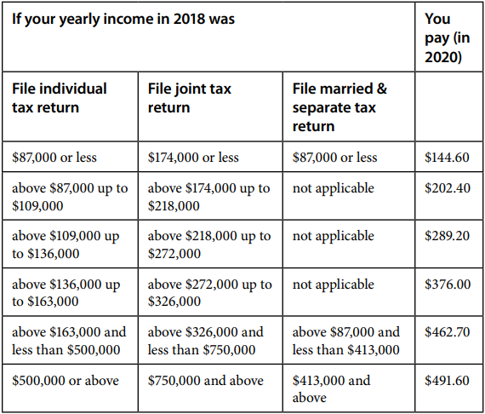
How Higher Income Boosts Medicare Part B Monthly Premiums

Slide 6
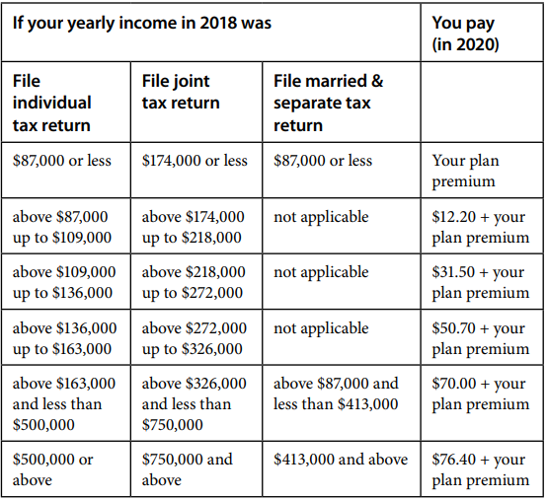
How Higher Income Boosts Medicare Part D (Drugs) Monthly Premiums

Slide 7
A Quick Tutorial on “Required Minimum Distributions” - RMDs
RMD Rules Prior to the End of 2019:
  Participants in traditional IRAs and qualified retirement plans must begin receiving distributions with the year in which they reach age 70-1/2
    For many donors, the additional Medicare costs could exceed $2,400 per person per year. A couple would need $7,400 so that, after paying income taxes, they’ll have the funds to pay these premium surcharges
    And then there’s the tax on the rest of the RMDs.
DINSMORE & SHOHL LLP • LEGAL COUNSEL • DINSMORE.COM
© 2020. ALL RIGHTS RESERVED

Slide 8
A Quick Tutorial on “Required Minimum Distributions” - RMDs
RMD Rules Prior to the End of 2019:
  Participants in traditional IRAs and qualified retirement plans must begin receiving distributions with the year in which they reach age 70-1/2
    And that’s not all. Once the money leaves the IRA, it loses the tax-free growth it would have enjoyed had it remained in the IRA. All of the tax free growth opportunity disappears, too. A simple example: for each $10,000 of forced RMD withdrawal that Amy and Allen Donor do not need now, Amy and Allen must part with $14,000 in lost tax-free growth over their lifetimes – and they must pay the additional $7,400 per year in Medicare premium surcharges.
    Moral: if there’s a way, it’s in Amy and Allen Donor’s best interest to minimize those RMDs. (Stay tuned…that opportunity exists for this year!)
DINSMORE & SHOHL LLP • LEGAL COUNSEL • DINSMORE.COM
© 2020. ALL RIGHTS RESERVED

Slide 9
A Quick Tutorial on “Required Minimum Distributions” - RMDs
RMD Rules Prior to the End of 2019:
  Distributions to beneficiaries: Over the lifetime of the beneficiary
    Use life expectancy of beneficiary.
    The younger the beneficiary, the longer the “stretch out” period for distributions, the longer IRA balances can grow tax free.
DINSMORE & SHOHL LLP • LEGAL COUNSEL • DINSMORE.COM
© 2020. ALL RIGHTS RESERVED

Slide 10
A Quick Tutorial on “Required Minimum Distributions” - RMDs
RMD Rules Prior to the End of 2019:
    Example. Edith Donor has designated her grandchild as beneficiary of her IRA. Grandchild is 35. Distribution period for a 35 year old: 48.5 years – 1/48.5; 1/47.5. Distributions won’t rise to 5% of the IRA balance for almost 20 years! And we still have another almost 20 years to go, sheltering the IRA and allowing it to continue to grow. This should sustain Grandchild for a long time! Edith has little incentive to designate Charity as beneficiary of this IRA.
DINSMORE & SHOHL LLP • LEGAL COUNSEL • DINSMORE.COM
© 2020. ALL RIGHTS RESERVED

Slide 11
A Quick Tutorial on “Required Minimum Distributions” - RMDs
The SECURE Act Increases the Age for Determining the Required Beginning Date to Age 72
    For everyone who attains age 70-1/2 in 2020, the required beginning date is April 1 of the calendar year following the calendar year in which the individual attains age 72
    Attained age 70-1/2 in 2019? The new rule doesn’t apply – the old rules continue to apply. But stay tuned for good news!
DINSMORE & SHOHL LLP • LEGAL COUNSEL • DINSMORE.COM
© 2020. ALL RIGHTS RESERVED

Slide 12
A Quick Tutorial on “Required Minimum Distributions” - RMDs
The SECURE Act Changes the Rules for Distributions to Beneficiaries
  Stretch Payouts Eliminated for Most Non-Spouse Beneficiaries, Beginning in 2020 for Owners Who Die After December 31, 2019
    Most non-spouse beneficiaries must receive the entire IRA balance within 10 years after the death of the IRA owner.
    Only exceptions: if the beneficiary is a surviving spouse, a minor child, a disabled or chronically ill individual, and beneficiaries who are less than ten years younger than the decedent.
DINSMORE & SHOHL LLP • LEGAL COUNSEL • DINSMORE.COM
© 2020. ALL RIGHTS RESERVED

Slide 13
A Quick Tutorial on “Required Minimum Distributions” - RMDs
The SECURE Act Changes the Rules for Distributions to Beneficiaries
  Stretch Payouts Eliminated for Most Non-Spouse Beneficiaries, Beginning in 2020 for Owners Who Die After December 31, 2019
    Result: IRAs are far less desirable tools to help support children and grandchildren.
    The 10 year mandatory pay-out period bunches distributions:
      That increases income tax
      Puts wealth quickly into the hands of younger beneficiaries
      Result: Edith Donor’s intentions and desires may not be fulfilled. Her rich uncle – “Uncle Sam” – becomes a new beneficiary of the IRA and is very happy.
DINSMORE & SHOHL LLP • LEGAL COUNSEL • DINSMORE.COM
© 2020. ALL RIGHTS RESERVED

Slide 14
A Quick Tutorial on “Qualified Charitable Distributions” – “QCDs”

Slide 15
A Quick Tutorial on “Qualified Charitable Distributions” - QCDs
QCDs Are Income-Tax Free – and They Suppress Medicare Premiums, Too
  A “’qualified charitable distribution” is a transfer from a traditional IRA directly to a “public charity” by
    An IRA account owner who, has attained age 70-1/2 before the transfer occurs. (The SECURE Act did NOT change this age.)
    OR
    The beneficiary of an inherited traditional IRA who has attained age 70-1/2 before the transfer occurs.
  The maximum amount that can qualify as a QCD: up to $100,000 per year
DINSMORE & SHOHL LLP • LEGAL COUNSEL • DINSMORE.COM
© 2020. ALL RIGHTS RESERVED

Slide 16
A Quick Tutorial on “Qualified Charitable Distributions” - QCDs
QCDs Are Income-Tax Free – and They Suppress Medicare Premiums, Too
    Can I make a QCD from the qualified plan in which I participate? No. I must first effect a transfer from my qualified plan to a traditional IRA – and then make my QCDs from the traditional IRA.
    Can I make a QCD from my 403(b) plan? My Simple IRA? My SEP IRA? No, No, and No.
    Can I make a QCD to my donor advised fund? No.
DINSMORE & SHOHL LLP • LEGAL COUNSEL • DINSMORE.COM
© 2020. ALL RIGHTS RESERVED

Slide 17
A Quick Tutorial on “Qualified Charitable Distributions” - QCDs
QCDs Are Income-Tax Free – and They Suppress Medicare Premiums, Too
  What do QCDs do for me?
    They count toward my RMD requirement for the year. That saves me income taxes, reduces my Medicare premiums, and preserves tax-free growth in my IRA.
DINSMORE & SHOHL LLP • LEGAL COUNSEL • DINSMORE.COM
© 2020. ALL RIGHTS RESERVED

Slide 18
A Quick Tutorial on “Qualified Charitable Distributions” - QCDs
QCDs Are Income-Tax Free – and They Suppress Medicare Premiums, Too
  What do QCDs do for me?
    They are totally excluded from my income for income tax purposes. That’s better than an itemized deduction:
      Most donors won’t be itemizing any more, since the new standard deduction is now so high ($24,800 for joint filers for 2020)
      QCDs let donors keep their cake and eat it, too: they can claim the standard deduction and obtain the benefits of a deduction for their QCDs
      Itemized deductions don’t reduce Ohio state income taxes, and they won’t reduce exposure to higher Medicare premiums. QCDs accomplish both feats!
DINSMORE & SHOHL LLP • LEGAL COUNSEL • DINSMORE.COM
© 2020. ALL RIGHTS RESERVED

Slide 19
The Rules That Usually Apply If You Want to Rollover a Distribution from a Plan or IRA Back to the Distributing Plan/IRA or to Another IRA

Slide 20
The Rules That Usually Apply If You Want to Rollover a Distribution from a Plan or IRA Back to the Distributing Plan/IRA or to Another IRA
Direct Transfers from One IRA Custodian to Another IRA Custodian or from a Qualified Plan to an IRA
    No limit on the number of transfers
    Rollovers -- Distribution to Owner, and from Owner Back to Distributing Arrangement or to Another IRA ((remember – the general rule is, RMDs cannot be rolled over)
    Distribution from Qualified Plan: must complete the rollover within 60 days
    Distribution from IRA:
      Must complete the rollover within 60 days
      AND
      Only one rollover during any 12 consecutive month period, taking into account all IRAs
      Jeremy Donor has two IRAs, IRA #1 and IRA #2. Jeremy received a distribution from IRA #1 on July 1, 2019 and rolled over the distribution to IRA #2. Jeremy may not rollover any distributions from either IRA #1 OR IRA #2 again until July 1, 2020.
DINSMORE & SHOHL LLP • LEGAL COUNSEL • DINSMORE.COM
© 2020. ALL RIGHTS RESERVED

Slide 21
What Did the CARES Act Do For Donors Who Must Receive RMDs?

Slide 22
The CARES Act Eliminates the Need to Receive RMDs for 2020
  CARES Act enacted on March 27, 2020
  RMDs for qualified plans and IRAs are waived for 2020. (Individuals who wish to receive what would otherwise be a RMD may still do so.) (Roth IRAs aren’t subject to the RMD requirement.)
  The waiver applies to everyone who attained age 70-1/2 in 2019 or before.
  The waiver also applies to individuals who turned 70-1/2 in 2019 and did not receive the 2019 RMD by January 1, 2020.

Slide 23
The CARES Act Eliminates the Need to Receive RMDs for 2020
  Result: If Donors received a 2020 RMD (or, in the case of Donor who attained age 70-1/2 in 2019 and hadn’t received the 2019 RMD by January 1, 2020), that distribution lost its taint as an RMD. Donors could avoid all of the terrible consequences of receiving an RMD they really didn’t need, by rolling over the unwanted distributions to an IRA!

Slide 24
The CARES Act Eliminates the Need to Receive RMDs for 2020
  The problem: Since the CARES Act wasn’t enacted until March 27, 2020, many donors may have already received RMD distributions for 2020 and could not roll them over because of either the 60 day rule or the not more than once in 12 months rule.

Slide 25
The CARES Act Eliminates the Need to Receive RMDs for 2020
  Example. Bill Donor receives his RMDs from his IRA in the form of monthly distributions. He received the 2020 RMD monthly distributions on January 26, 2020, February 26, 2020 and March 26, 2020.
    The 60 day rule will make it impossible to rollover the January distribution
    Bill Donor can rollover the February distribution – if he hurries and completes the rollover by April 25. That was difficult for most donors, for they may not have learned of the issue in time.
    If Bill Donor did successfully meet the 60 day rule for the February distribution, the not more than once in 12 months rule prohibits rolling over the March distribution.

Slide 26
The IRS Comes to the Rescue

Slide 27
The IRS Comes to the Rescue
  IRS Notice 2020-23 extended the permissible 60-day rollover period until July 15, 2020, but only for distributions received between February 1, 2020 and May 15, 2020.
  Rats. It’s already well beyond May 15 – and Notice 2020-23 did not waive the not more than once in 12 months rule. That doesn’t do Bill Donor any good.
DINSMORE & SHOHL LLP • LEGAL COUNSEL • DINSMORE.COM
© 2020. ALL RIGHTS RESERVED

Slide 28
The IRS Comes to the Rescue Again
  IRS Notice 2020-51: IRS has expanded the ability to make rollovers in three ways for IRA owners:
  All distributions received since January 1, 2020 are now eligible for rollover
  Rollovers now can be completed by AUGUST 31, 2020
  IRS has waived the not more than once in 12 months rule, too.
DINSMORE & SHOHL LLP • LEGAL COUNSEL • DINSMORE.COM
© 2020. ALL RIGHTS RESERVED

Slide 29
The IRS Comes to the Rescue Again
  IRS Notice 2020-51: IRS has expanded the ability to make rollovers in three ways for IRA owners:
  Watch out: Notice 2020-51 says that IRA owners and non-spouse beneficiaries who received a 2020 RMD and who need relief from the 60 day rule or the not more than once in 12 months rule in order to complete a rollover must repay the distribution to the IRA from which the distribution was received.
DINSMORE & SHOHL LLP • LEGAL COUNSEL • DINSMORE.COM
© 2020. ALL RIGHTS RESERVED

Slide 30
Tips for Our Donors

Slide 31
Tips for Our Donors
Remember the Plight of Bill Donor?
    Bill Donor received three monthly distributions. What can Bill do?
DINSMORE & SHOHL LLP • LEGAL COUNSEL • DINSMORE.COM
© 2020. ALL RIGHTS RESERVED

Slide 32
Tips for Our Donors
Remember the Plight of Bill Donor?
    Bill can
      Return all three monthly distributions to the distributing IRA. Phew! We’ve just avoided tax for 2020 and postponed any increased Medicare premiums. But Bill also boosted the size of the IRA – and that will increase RMDs next year.
      Bill could create a new IRA and directly transfer the returned amounts from Old IRA to New IRA (there are no limits on these transfers)
      Bill now has an IRA that he can use to:
        Designate Charity as the beneficiary; and
        Make QCDs. Those QCDs can help Charity now – they can also go into Charity’s Endowment Fund to permanently benefit Charity!
DINSMORE & SHOHL LLP • LEGAL COUNSEL • DINSMORE.COM
© 2020. ALL RIGHTS RESERVED

Slide 33
Tips for Our Donors
Remember the Plight of Bill Donor?
    Bill can
      Bill simplifies his charitable and estate planning.
      Bill can care for children and grandchildren with stocks, for example, instead of as IRA beneficiaries:
        no tax to children/grandchildren when they sell for they get a “stepped up basis.”
        And whatever’s left in the IRA goes to Charity – all of it, without tax!
DINSMORE & SHOHL LLP • LEGAL COUNSEL • DINSMORE.COM
© 2020. ALL RIGHTS RESERVED

Slide 34
Questions?

